Slide 1
Course Introduction
Prof. Dr. Dirk Riehle
Friedrich-Alexander University Erlangen-Nürnberg
AMSE A01
Notes:
It is Friedrich-Alexander University Erlangen-Nürnberg – FAU, in short.
Corporate identity wants us to say “Friedrich-Alexander University”.

Slide 2
Advanced Methods of Software Engineering
Advanced methods du jour, this semester
  Test-driven development
  Lean software development
  Continuous integration / delivery
  (Micro)service architectures

Slide 3
Course Learning Goals
Learn and apply
  Advanced methods of agile software engineering
  In a real project setting with a strong development lead

Slide 4
Teaching Approach
One single semester-long project
Weekly team meetings and homework
Coaching by strong development lead

Slide 5
Skills Required for Course
Strong programming skills
Learn new technology by yourself
Solve minor development issues by yourself

Slide 6
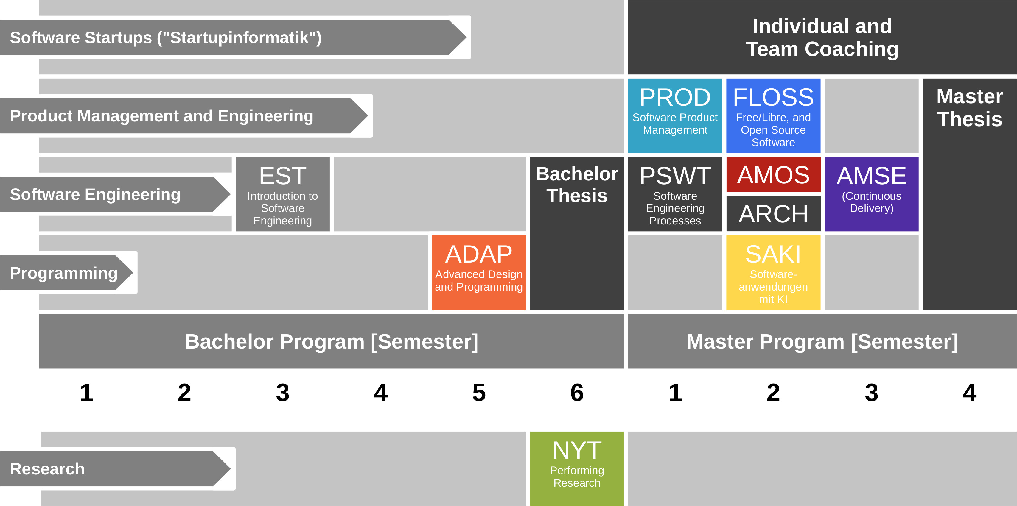
Course Position in Curriculum

Slide 7
Courses and Modules
 |  | Courses (Lehrveranstaltungen)
 |  | OSS-AMSE-VUE |  | Total ECTS
Modules | OSS-AMSE | x |  | 5

Slide 8
Course Grading [1]
Discrete weekly grading using [0|1|2|3] scheme
  0 = no work
  1 = minimal work
  2 = expected work
  3 = exceptional work
Moderated by final presentation and documentation
[1] Also see http://osr.cs.fau.de/teaching/course-resources/grading-schemes-and-scales/

Slide 9
Receiving a Grade for the Course
If you want to receive a grade
  You must register through the course management system
If you cannot register through the course management system
  Please follow these instructions: https://wp.me/PDU66-2bx
Otherwise: No grade

Slide 10

No Oral or Written Exam [1]
[1] You still have to register for the course

Slide 11
Course Language [1]
Class
  Joint choice of German or English
Homework
  Source code: English
  Submissions: Choice of German or English
[1] See http://osr.cs.fau.de/2012/03/10/english-or-german-deutsch-oder-englisch/

Slide 12

Course Communication
Announcements by email (through StudOn)
Questions and answers using FSI Forum for course
If you must send email, use the teaching team alias from course index

Slide 13
Project Contributor Agreement
For contributions to our projects, we require a rights grant
  We use the Sun Contributor Agreement
    Available here: http://osr.cs.fau.de/teaching/contributor-agreement/

Slide 14
Course Information
Course Index
  https://goo.gl/OBUIHA

Slide 15
Thank you! Questions?
dirk.riehle@fau.de – http://osr.cs.fau.de
dirk@riehle.org – http://dirkriehle.com – @dirkriehle
DR

Slide 16
Credits and License
Original version
  © 2015-2019 Dirk Riehle, all rights reserved
Contributions
  …

